Slide 1


Olist E-commerce Data Analysis Project

Slide 2
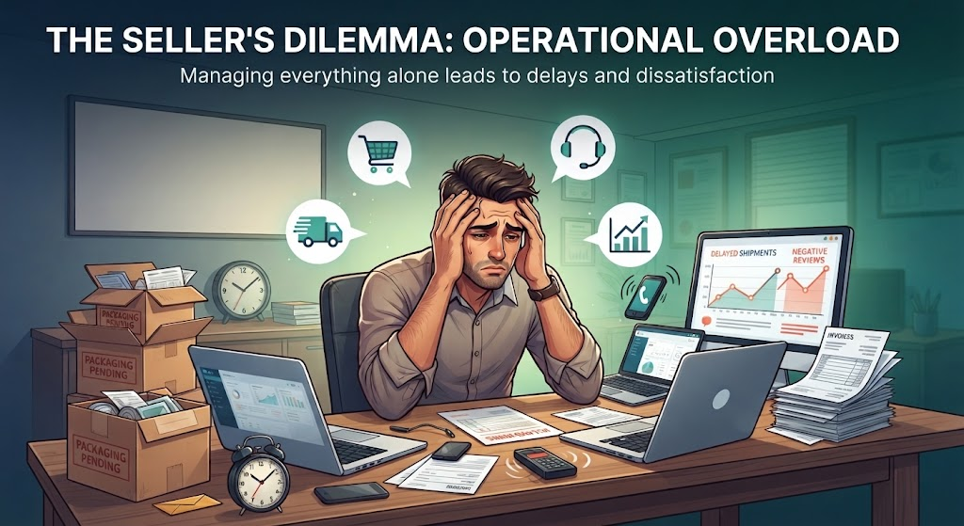
The Seller's Dilemma: Operational Overload
  The Burden of Multi-Tasking: Sellers on the platform struggle with wearing multiple hats—managing inventory, tracking logistics, handling customer service, and processing orders manually.
  The Operational Bottleneck: Trying to handle everything alone leads to delayed shipments, missed customer expectations, and unexpected negative reviews.
  The Business Need: A data-driven approach is essential to automate insights, identify supply chain gaps, and scale operations efficiently without burning out.

Slide 3
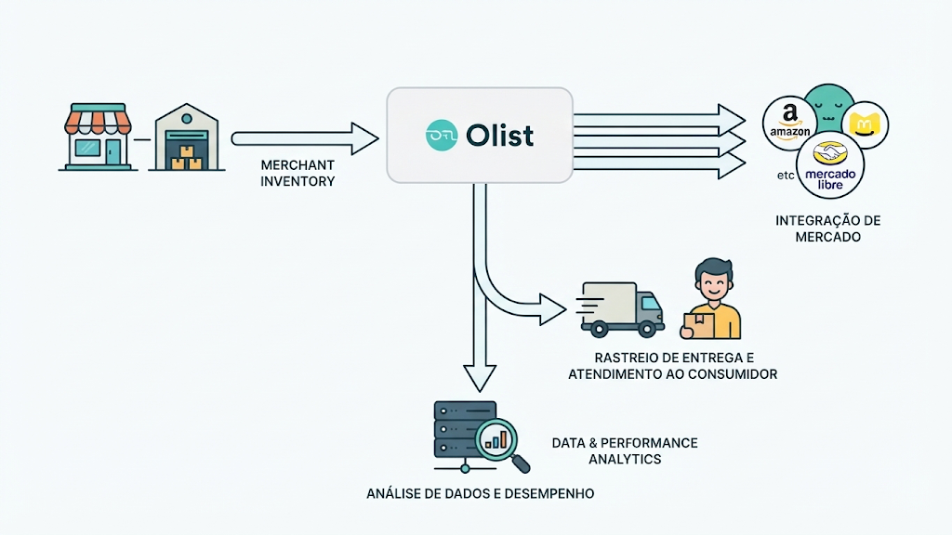
?Who is Olist
  The Bridge: A Brazilian marketplace integrator connecting small merchants to major online platforms.
  The Core Role: Manages inventory, pricing, payments, and delivery tracking.
  Our Goal: Analyze their ecosystem data to uncover business insights.

Slide 4

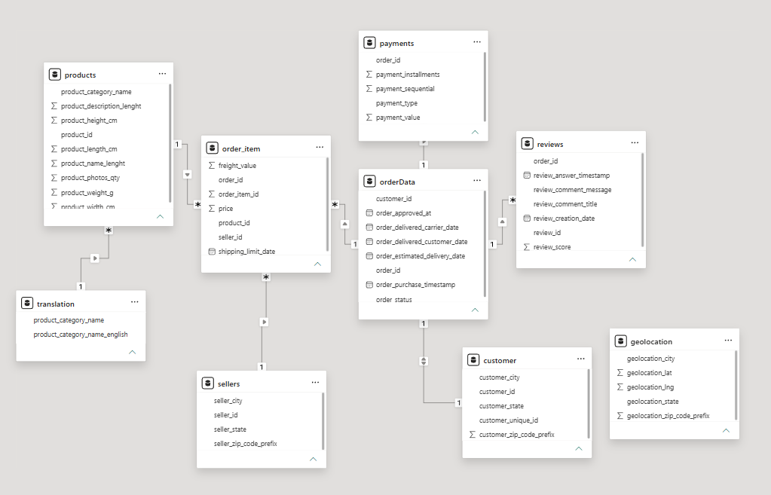

Project Scope & Methodology
Dataset Size: 100K+ real Brazilian e-commerce orders (2016–2018).
Core Tables: Customers, Orders, Payments, Items, Products, and Sellers.
Tech Stack: Python (Pandas/Seaborn) for cleaning & exploratory analysis; SQL for relational queries.
Schema

Slide 5


Data Preprocessing
  Loaded 9 Olist CSV datasets
  Inspected data types & missing values
  Removed duplicated records where applicable
  Handled data inconsistencies
  Preserved meaningful NULL values in delivery/approval dates
  Prepared clean datasets for SQL Server

Slide 6
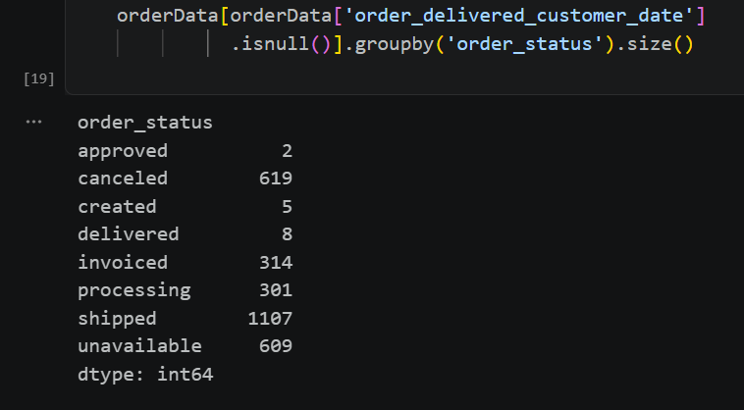
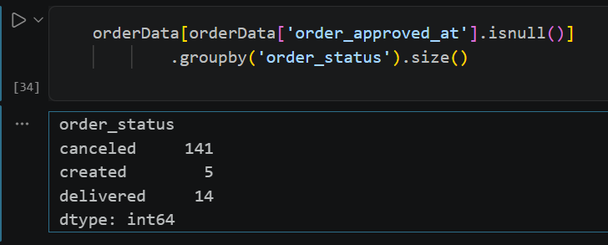
Data Transformation & Datetime Parsing
Investigating Null Values & Order Status

Slide 7

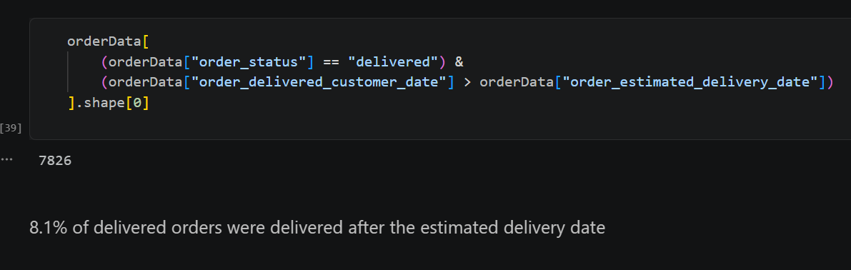
Identifying Delivery Bottlenecks & Late Shipments
  Insight: Detected that 8.1% of successfully delivered orders missed their estimated delivery date.
  Impact: Highlights supply chain and logistics delays affecting customer satisfaction.

Slide 8
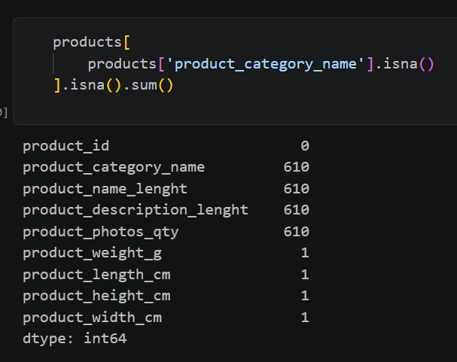
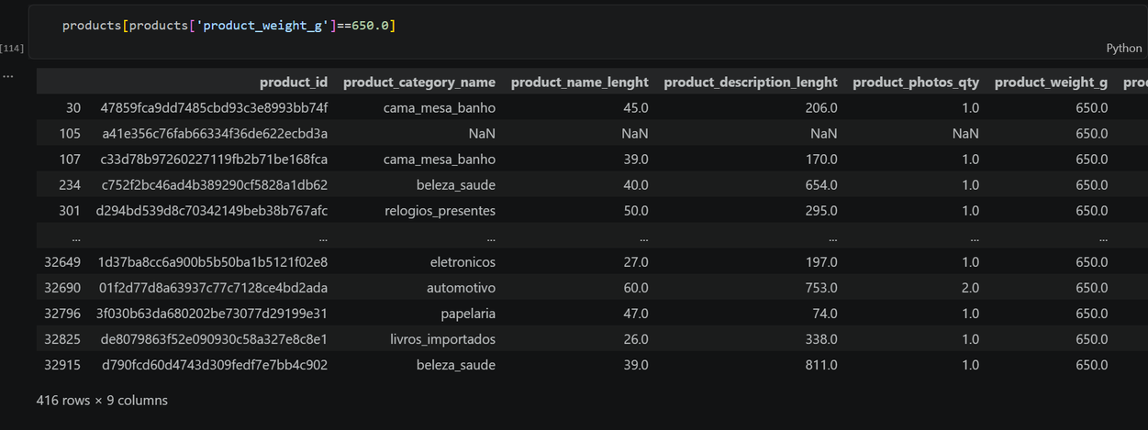
Handling Missing Product Categories & Feature Limitation
  Attempted Approach: Tried to impute missing category names by mapping product weights and dimensions (e.g., testing if specific weights correlate with unique categories).
  The Finding: Found that physical features like weight (e.g., 650g) overlap across multiple different categories, proving that simple imputation won't work accurately.
  Analytical Takeaway: Emphasizes data integrity—recognizing when missing data cannot be reliably filled without risking data distortion, choosing to keep them as-is rather than making inaccurate assumptions.

Slide 9

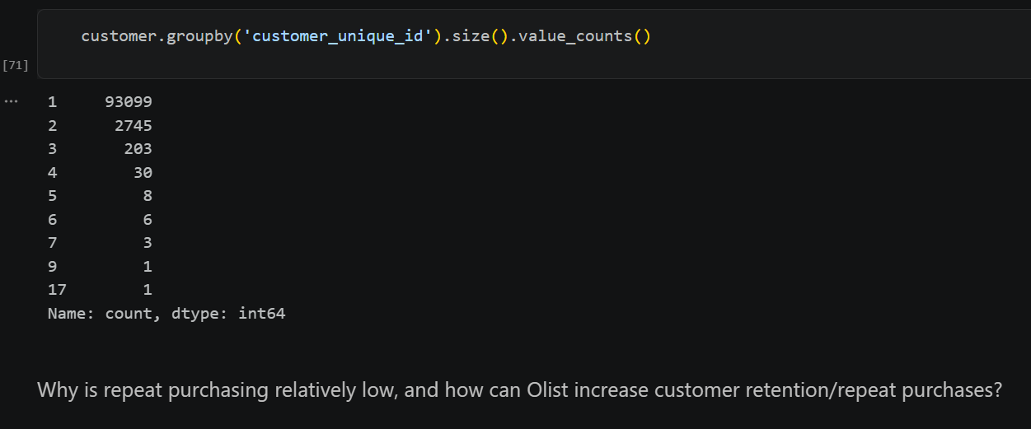

Customer Retention & Repeat Purchasing Analysis
  Key Insight: The vast majority of Olist customers are one-time buyers (~93K), showing relatively low repeat purchasing behavior.
  Business Question: Why is repeat purchasing low, and how can Olist increase customer retention and loyalty?
  Strategic Recommendation: Implement targeted email marketing campaigns, follow-up discounts, and loyalty programs to drive customer lifetime value (LTV).

Slide 10
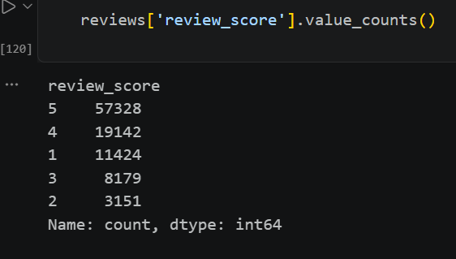

Customer Satisfaction & Review Score Distribution
  Key Insight: The majority of customer reviews are positive, with 5-star ratings dominating the dataset (~57K).
  The Challenge: A noticeable volume of 1-star reviews (~11.4K) indicates underlying customer pain points, which strongly correlates with the delivery delays we discovered earlier.
  Strategic Value: Tracking review scores helps Olist identify dissatisfaction drivers, improve service quality, and protect platform reputation.

Slide 11
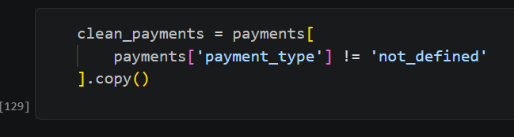
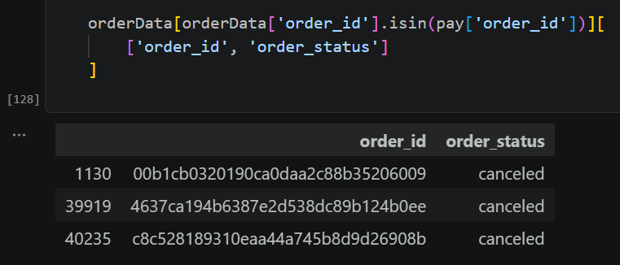
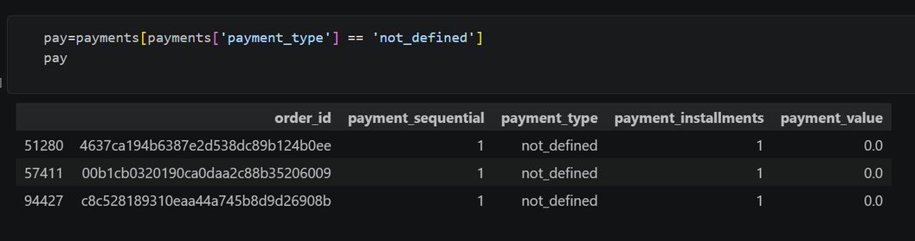
Handling Payment Anomalies & Data Cleaning
  nomaly Detection: Identified 3 anomalous payment records labeled as not_defined with a payment value of 0.0.
  Root Cause Investigation: Cross-referenced these payment IDs with the orders dataset to reveal that 100% of these anomalous orders were canceled.
  Data Cleaning Action: Created a filtered dataset (clean_payments) by dropping undefined payment types to ensure accurate financial and payment analytics.

Slide 12
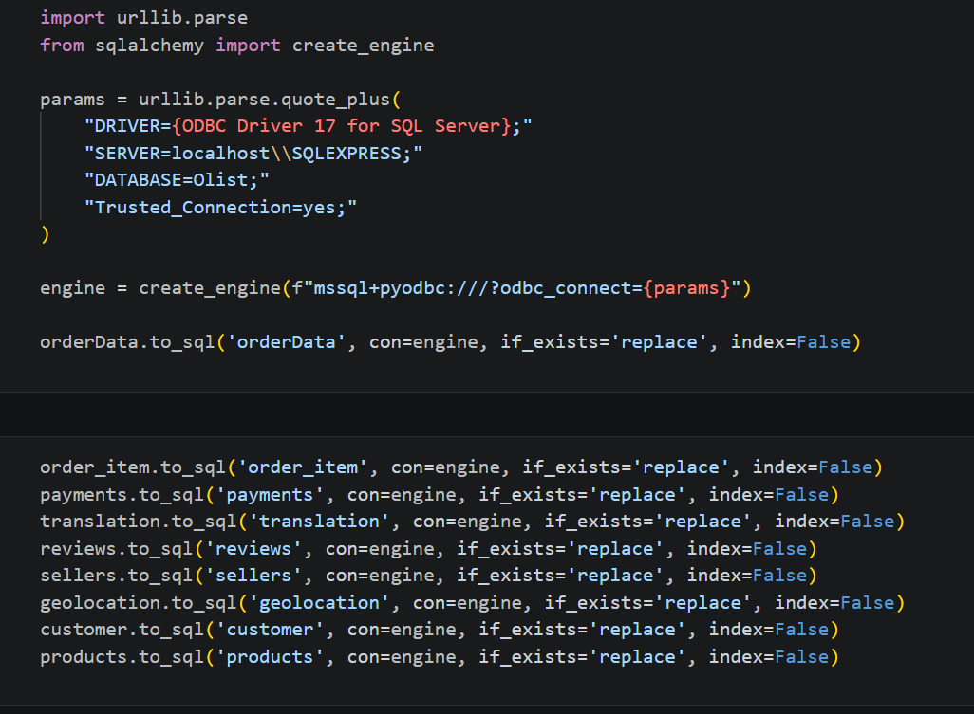
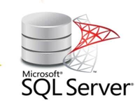


Database Migration & Pipeline Integration
  Pipeline Setup: Connected Python to SQL Server via SQLAlchemy and pyodbc.
  Data Ingestion: Exported cleaned DataFrames into relational SQL tables (orderData, payments, products, etc.).
  Next Step: Moving to SQL for advanced querying and relational analysis.

Slide 13
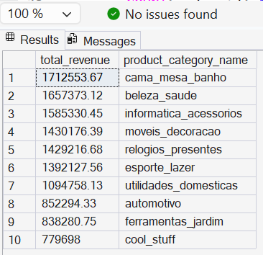
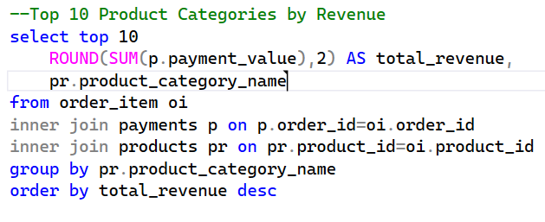

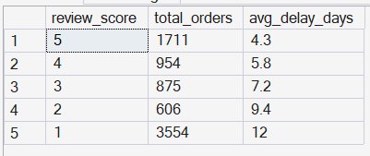
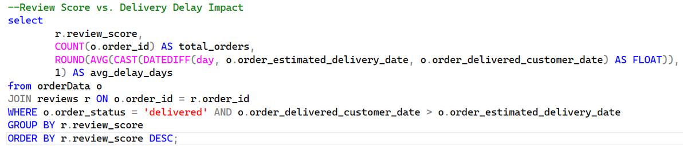
Advanced SQL Analysis & Querying

Slide 14
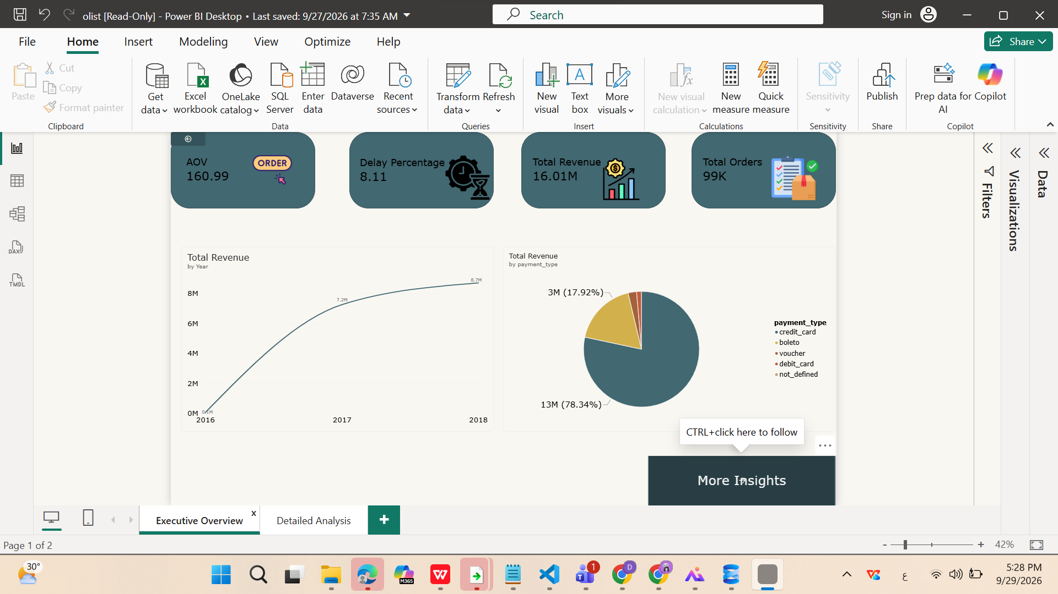

Slide 15
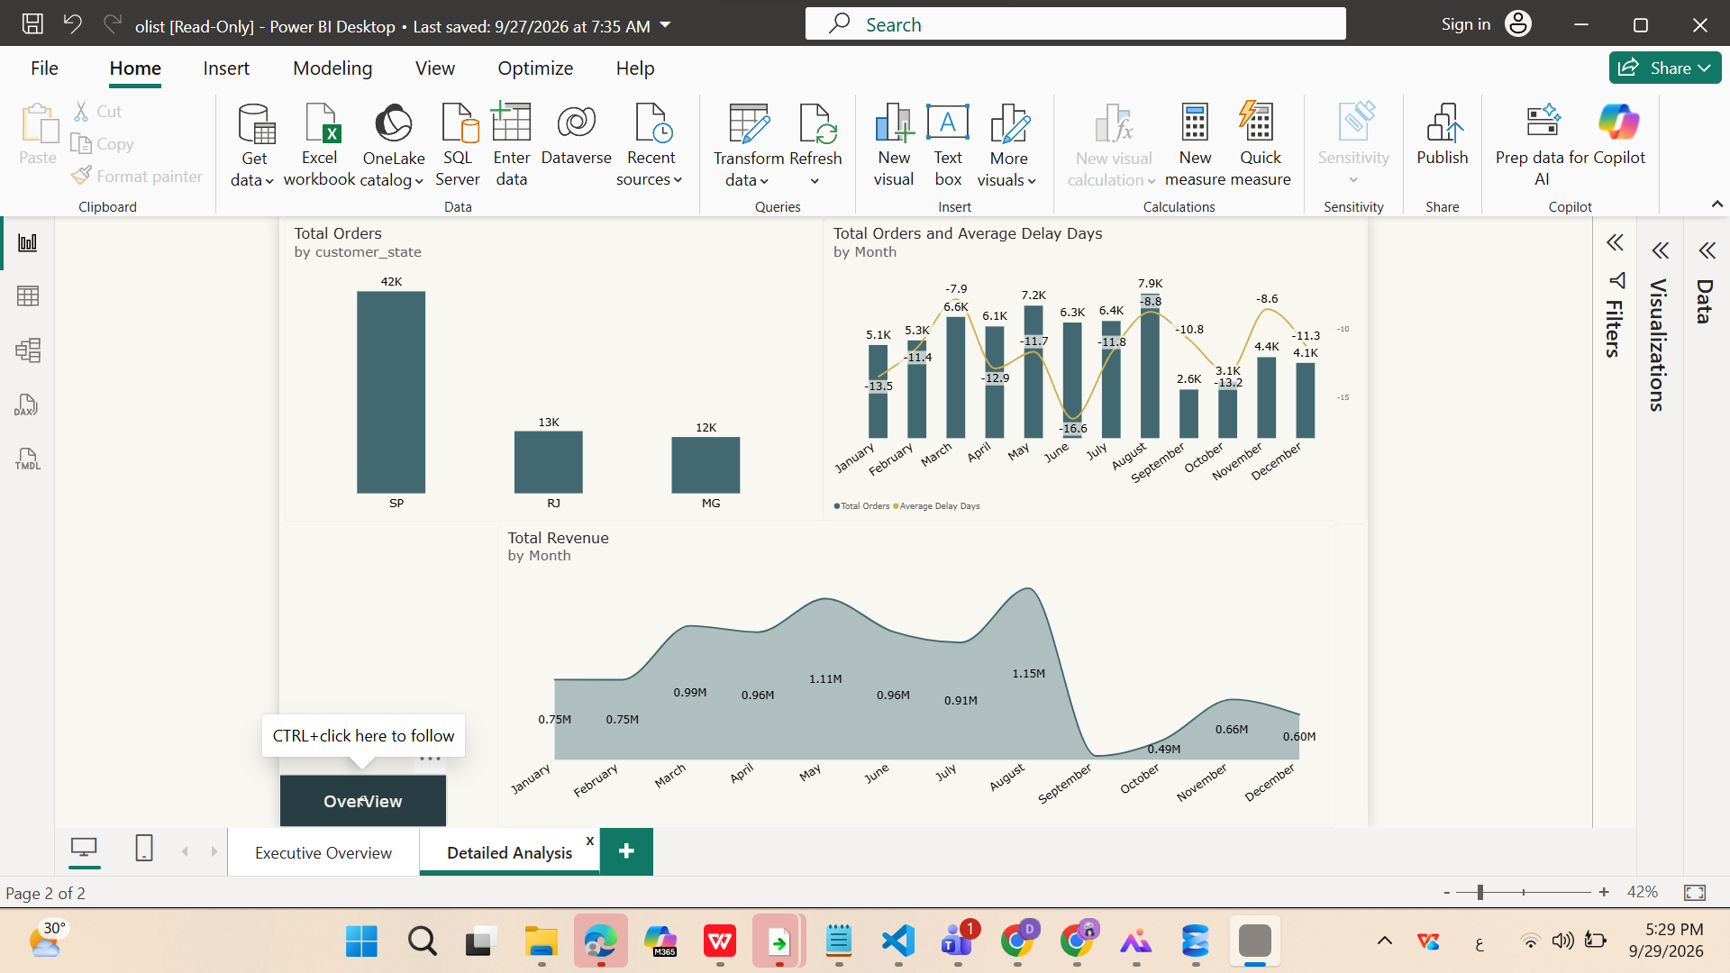

Slide 16


Strategic Solutions & Business Recommendations
  Logistics & Delivery Optimization:
    Monitor and filter poor-performing shipping carriers to minimize delay rates.
    Update delivery estimation algorithms to manage customer expectations accurately.
  Seller Operational Support:
    Introduce proactive warning systems for merchants facing order bottlenecks.
    Provide automated inventory and processing guidelines to prevent operational overload.
  Customer Retention Strategy:
    Launch automated second-purchase incentives and loyalty programs to drive repeat orders.
    Address root causes of negative reviews to rebuild long-term marketplace trust.

Slide 17



